Slide 1
Cryptography and Network Security
Visual Cryptography

Slide 2
Introduction
Visual cryptography is a cryptographic technique which allows visual information (pictures, text, etc.) to be encrypted in such a way that decryption becomes a mechanical operation that does not require a computer.
Such a technique thus would be lucrative for defense and security.
Plaintext is as an image.
Encryption involves creating “shares” of the image which in a sense will be a piece of the image.
Give the shares to the respective holders.
Decryption – involving bringing together the an appropriate combination and the human visual system.

Slide 3
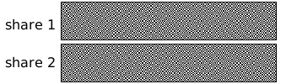
Concept of Secrecy
Two or more share images are produced from a secret image.
The secret image can only be revealed when all of the share images are brought together.

Slide 4
Concept of Secrecy
Basically it involves dividing the image into two parts:
  Key : a transparency
  Cipher : a printed page
Separately, they are random noise
Combination reveals an image

Slide 5
Secret Sharing - Visual
Refers to a method of sharing a secret to a group of participants.
Dealer provides a transparency to each one of the n users.
Any k of them can see the secret by stacking their transparencies, but any k-1 of them gain no information about it.
Main result of the paper include practical implementations for small values of k and n.

Slide 6
Background
The image will be represented as black and white pixels
Grey Level: The brightness value assigned to a pixel; values range from black, through gray, to white.
Hamming Weight (H(V)): The number of non-zero symbols in a symbol sequence.
Concept of qualified and forbidden set of participants.

Slide 7


Encoding the Pixels
Pixel
Share 1
Share 2
Overlaid

Slide 8
2 out of 2 scheme (2 sub-pixels)
Black and white image: each pixel divided in 2 sub-pixels
Choose the next pixel; if white, then randomly choose one of the two rows for white.
If black, then randomly choose between one of the two rows for black.
Also we are dealing with pixels sequentially; in groups these pixels could give us a better result.

Slide 9
2 out of 2 scheme (2 sub-pixels)

Slide 10
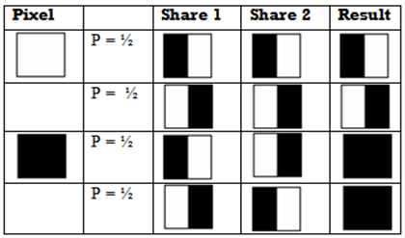

2 out of 2 scheme (2 sub-pixels)

Slide 11
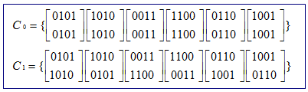
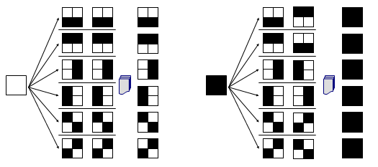
2 out of 2 scheme (4 sub-pixels)

Slide 12
Advantages of Visual Cryptography
Encryption doesn’t required any NP-Hard problem dependency
Decryption algorithm not required (Use a human Visual System). So a person unknown to cryptography can decrypt the message.
We can send cipher text through FAX or E-MAIL
Infinite Computation Power can’t predict the message.

Slide 13
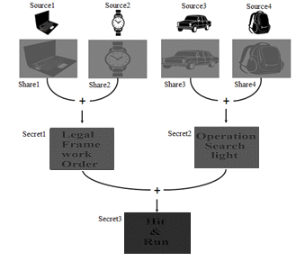



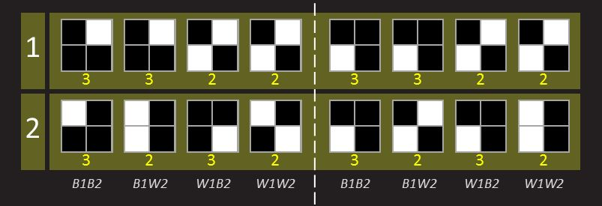
Hiding Secret Image
+

